Slide 1
Leveraging network topology for better fake account detection in social networks*
Proposal presentation
Björn Bebensee
bebensee@snu.ac.kr
Nagmat Nazarov
nagmat@snu.ac.kr
*working title

Slide 2
One of the biggest annoyances in social networks?

Slide 4
Fake accounts and bots!

Slide 7
Motivation
High number of fake accounts in online social networks (OSNs)
Fake accounts can serve a variety of (malicious) purposes:
Spamming
Malware distribution
Scams
Identity fraud
Boost popularity, i.e. fake followers
Increase visibility of certain content (see spamming)
Influence public opinion (or the perception thereof)

Slide 8
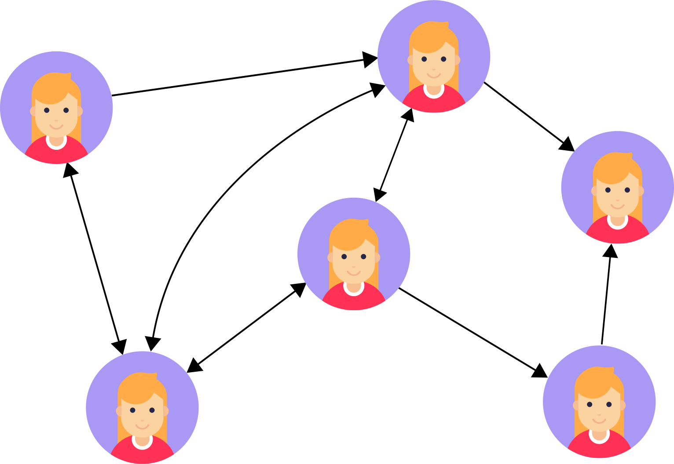
Problem definition
Observation: social networks are graphs!
social graph: graph of interactions, friend or follow relations

Slide 9
Problem definition
Given: directed graph G=(V,E)
Goal: identify all nodes that are fake accounts
Important: maintain a low false-positive rate

Slide 10
Related Work: Xiao et al., “Detecting Clusters of Fake Accounts in Online Social Networks”
build clusters of users based on account creation data
classify entire clusters rather than single users
pipeline divided in cluster builder, profile featurizer and account scorer
For our project:
Clustering may be useful to leverage similarities
Perhaps use clustering on graph features? Cluster nodes with similar graph structure

Slide 11
Related Work: Chowdhury et al., “Botnet detection using graph‐based feature clustering”
use graph-based features for clustering to identify botnets from network traffic
identify clusters of suspicious nodes, then classify only those most likely to be bots
Shortcomings:
slow
computation took 30 hours on a supercomputer albeit for a large dataset
For our project:
different dataset but very similar idea to ours
use topology of social graph to cluster suspicious nodes (user accounts)

Slide 12
Related Work: Cao et al., “Aiding the detection of fake accounts in large scale social online services”
observation: few connections between real users and fake accounts
therefore: random walks starting at real user less likely to end up at fake account
idea: use random walk probabilities to rank nodes, then manually remove accounts
For our project:
random walk probabilities are an interesting metric for classification
authors also provide way to compute it using power iteration

Slide 13
Related Work: Lundberg et al., “Towards a language independent Twitter bot detector”
language-independent approach to classify single tweets as auto generated or human-generated
use 10 features:
isReply
isRetweet
hashtagDensity, urlDensity, mentionDensity (# / # of words)
statusesPerDay, favoritesPerDay
accountReputation (# followers/(#following + #followers)
deviceType
tree-based models, specifically random forests (RF), performed best

Slide 14
Related Work: Lundberg et al., “Towards a language independent Twitter bot detector”
Shortcomings:
Only used a dataset of tweets in two languages, may perform better with more data
model only tested on one other (syntactically–related) language
may not really be language-independent
For our project:
consider features used in the paper for our classifier
focus on tree-based algorithms

Slide 15
Related Work: Cornelissen et al., “A network topology approach to bot classification”
topology of a user’s network (ego graph) may be sufficient to determine whether the user is an automated agent or human
approach uses features from ego graph to perform clustering
features used:
Network size
Density
Clustering coefficient
Centrality
Graph centralization
Reciprocity
Assortativity
Articulation points

Slide 16
Related Work: Cornelissen et al., “A network topology approach to bot classification”
Use for our project:
Paper suggests ego graph-based approach works
Use the features shown to be effective
Authors suggest combining graph-based approach with other features

Slide 17
Related Work: Harun et al., “Bot Classification for Real-Life Highly Class-Imbalanced Dataset”
Classifying botnets in a class-imbalanced network dataset
Experiments with different supervised learning algorithms on this imbalanced datasets:
Random forests (RF), KNN, SVM perform poorly for imbalanced datasets
Gaussian Naïve Bayes (GNB), Quadratic discriminant analysis (QDA) better for imbalanced datasets
Use for our project:
Use GNB, QDA for imbalanced datasets
When using RF, KNN, SVM try to keep the dataset well-balanced

Slide 18
Proposed approach
Simple idea:
Fake accounts and bots don’t have the same social structure as real users
Use graph features and ego graph topology to identify fake accounts
Clustering nodes according to their graph features (see also: community detection)

Slide 19
Proposed approach
Next steps:
Find a good labelled dataset, scrape social graph data
Explore graph data, feature engineering
Run experiments on the data
Develop a classification approach based on the experiments
Evaluate our approach

